Slide 1
COCOMO Models
Software Process and Project Metrics

Slide 2
COCOMO Versions
CO (Constructive) CO (Cost) MO (Model)
First version: 1981 by Dr. Barry Boehm
  Now known now as “COCOMO 81”
Second version: ADA Cocomo (ADA 87); parameterized exponent reflecting more modern practices and their economies of scale.
Current Version: Cocomo II (circa 2000)
Commercial take-offs
  Costar (Softstarsystems.com)
  Cost Xpert (CostXpert.com)

Slide 3
Application
The COCOMO cost estimates only cover the period between beginning of the design phase and end of the integration and test phase. Costs and schedules of other phases ( like requirement phase) are estimated separately.
COCOMO assumes that the requirement specification is not substantially changed after the plans and requirement phase.

Slide 4
Introduction to COCOMO models
The COstructive COst Model (COCOMO) is the most widely used software estimation model in the world.
The COCOMO model predicts the effort and duration of a project based on inputs relating to the size of the resulting systems and a number of "cost drivers" that affect productivity.

Slide 5
COCOMO: Some Assumptions
Primary cost driver is the number of Delivered Source Instructions (DSI) developed by the project.
COCOMO estimates assume that the project will enjoy good management by both the developer and the customer.
Assumes the requirements specification is not substantially changed after the plans and requirements phase.

Slide 6
Cost of a project
The cost in a project is due to:
  the requirements for software, hardware and human resources
  the human resources needed
    most cost estimates are measured in person-months (PM)

Slide 7
Cost of a project
The cost of the project depends on the nature and characteristics of the project, at any point, the accuracy of the estimate will depend on the amount of reliable information we have about the final product.

Slide 8
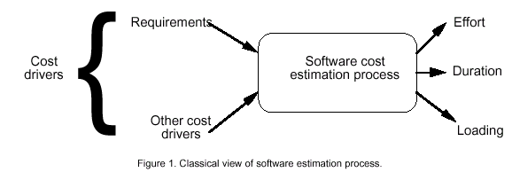
Software Cost Estimation

Slide 9
Effort
Effort Equation
  PM = C * (KDSI)^{n} (person-months)
    where PM = number of person-month (=152 working hours),
    C = a constant,
    KDSI = thousands of "delivered source instructions" (DSI) and
    n = a constant.

Slide 10
Productivity
Productivity equation
  (DSI) / (PM)
    where PM = number of person-month
    (152 working hours),
    DSI = "delivered source instructions"

Slide 11
Schedule
Schedule equation
  TDEV = C * (PM)^{n} (months)
    where TDEV = number of months estimated for software development.

Slide 12
Average Staffing
Average Staffing Equation
  (PM) / (TDEV) (FSP)
    where FSP means Full-time-equivalent Software Personnel.

Slide 13
COCOMO Models
COCOMO is defined in terms of three different models:
  the Basic model,
  the Intermediate model &
  the Detailed model.
The more complex models account for more factors that influence software projects, and make more accurate estimates.

Slide 14
The Development mode
The most important factors contributing to a project's duration and cost is the Development Mode.
    Organic Mode: The project is developed in a familiar, stable environment, and the product is similar to previously developed products. The product is relatively small, and requires little innovation.
    Semidetached Mode: The project's characteristics are intermediate between Organic and Embedded.

Slide 15
The Development mode
The most important factors contributing to a project's duration and cost is the Development Mode:
    Embedded Mode: The project is characterized by tight, inflexible constraints and interface requirements. An embedded mode project will require a great deal of innovation.

Slide 16
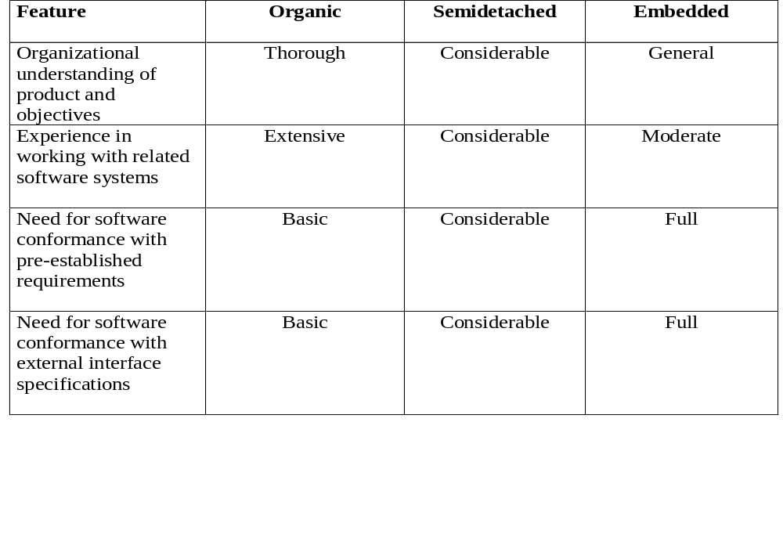
Modes
SEG3300 A&B W2004
R.L. Probert

Slide 17
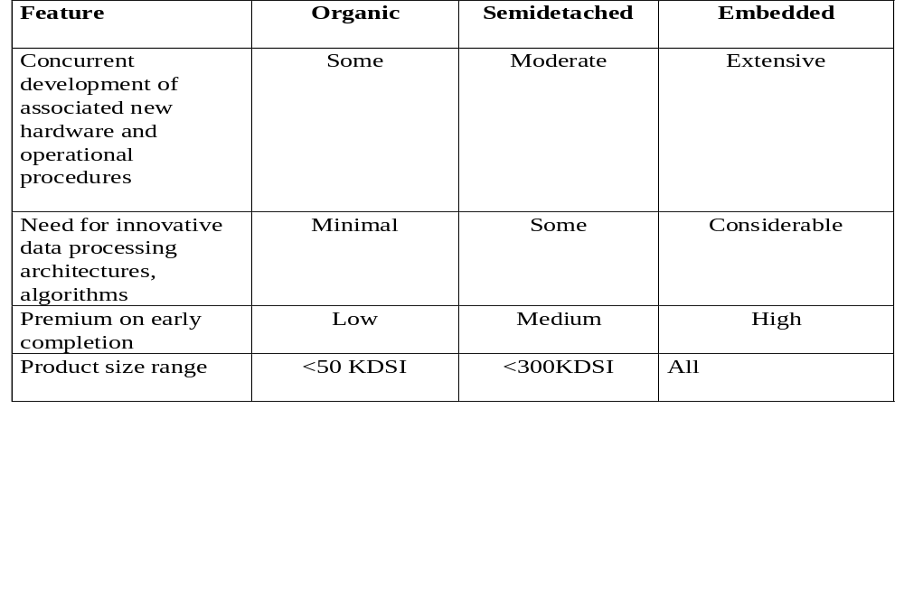
Modes
SEG3300 A&B W2004
R.L. Probert

Slide 18
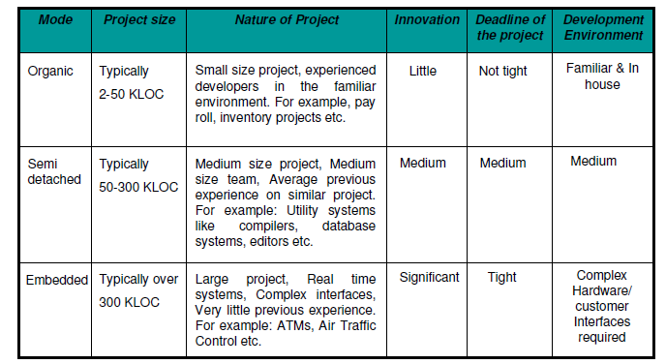
Comparison of three COCOMO modes

Slide 19
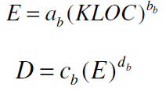
Basic Mode
Basic COCOMO model takes the form
Where E is effort applied in Person-Month, and D is the development tie in month.

Slide 20
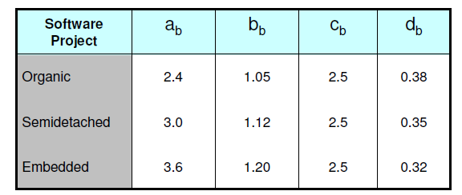
Basic COCOMO Coefficient
The coefficient a_{b}, b_{b}, c_{b}, and d_{b} are shown in the following table .

Slide 21
COCOMO Project classes
Organic mode: small teams, familiar environment, well-understood applications, no difficult non-functional requirements (EASY) | Effort = 2.4 (KDSI) ^{1.05} × M
Semi-detached mode: Project team may have experience mixture, system may have more significant non-functional constraints, organization may have less familiarity with application (HARDER) | Effort = 3 (KDSI) ^{1.12} × M
Embedded: Hardware/software systems, tight constraints, unusual for team to have deep application experience (HARD) | Effort = 3.6 (KDSI) ^{1.2} × M
KDSI = Kilo Delivered Source Instructions

Slide 22


Contd…
When effort and development time are known, the average staff size to complete the project may be calculated as:
When project size is known, the productivity level may be calculated as:

Slide 23
Basic COCOMO Model
Basic COCOMO model estimates the software development effort using only a single predictor variable (size in DSI) and three software development modes.

Slide 24
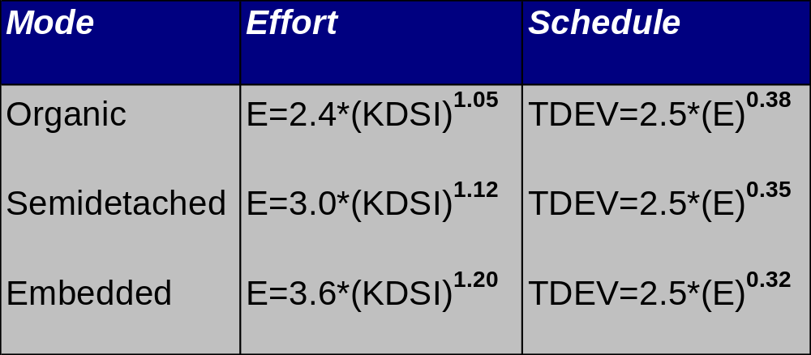
Basic COCOMO Model: Equations
Notes:
Effort in man-months
A COCOMO man-month consists of 152 hours of working time
KDSI is the Thousand Delivered Source Instructions
TDEV is the number of months estimated for software development

Slide 25
Basic COCOMO Model: When Should You Use It
Basic COCOMO is good for quick, early, rough order of magnitude estimates of software costs.
A project has 32,000 Delivered Source Instructions. Compute Effort, Schedule, Productivity & Average Staffing?

Slide 26
Basic COCOMO Model: Example
A project has 32,000 Delivered Source Instructions. This project fits the characteristics of Semi-Detached mode
Using the formulas, we can estimate:
Effort = 3.0*(32) ^{1.12} = 146 man-months
Schedule = 2.5*(146) ^{0.35} = 14 months
Productivity = 32,000 DSI / 146 MM
= 219 DSI/MM
Average Staffing = 146 MM /14 months
= 10 FSP
Notes:
FSP = Full-time equivalent Software Personnel, a measure of the equivalent number of people working on the project at a given time.

Slide 27
COCOMO Basic Illustration
Consider a software project using semi-detached mode with 30,000 lines of code . We will obtain estimation for this project as follows:
Effort estimation, E= a_{b}(KLOC)Exp(b_{b})PM
E=3.0(30)^{1.12} where lines of code=30 KLOC
E=135 person-month
(2) Duration estimation, D=c_{b}(E)Exp(d_{b})months
=2.5(135)^{0.35} =14 months
(3) Person estimation, N=E/D
=135/14
N=10 persons approx.

Slide 28
Example 1
Suppose that a project was estimated to be 400 KLOC.
Calculate the effort and development time for each of the three modes i.e., organic, semidetached and embedded.

Slide 29


Solution
The basic COCOMO equation take the form:
Estimated size of the project = 400 KLOC
(i) Organic mode

Slide 30


Contd…
Semidetached Mode
Embedded Mode

Slide 31
Example 2
A project size of 200 KLOC is to be developed. Software development team has average experience on similar type of projects. The project schedule is not very tight.
Calculate the effort, development time, average staff size and productivity of the project.

Slide 32



Solution
The semi-detached mode is the most appropriate mode; keeping in view the size, schedule and experience of the development team. Hence,
Average Staff Size (SS)=

Slide 33
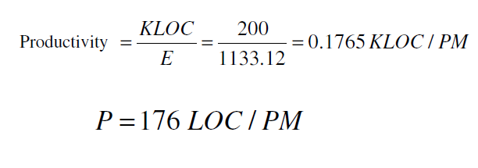
Solution

Slide 34
Drawbacks
Basic COCOMO is good for quick, early, rough order of magnitude estimates of software costs.
Its accuracy is necessarily limited because of its lack of factors to account for difference in hardware constraints, personnel quality and experience, use of modern tools and techniques, and other project attributes known to have a significant influence on software costs.

Slide 35
Intermediate COCOMO Model

Slide 36
Intermediate COCOMO Model
The Intermediate Model estimates the software development effort by using fifteen cost driver variables besides the size variable used in Basic COCOMO.

Slide 37
Intermediate COCOMO Model
Four areas for drivers:
  Product itself
  Computer
  Personnel
  Project itself

Slide 38
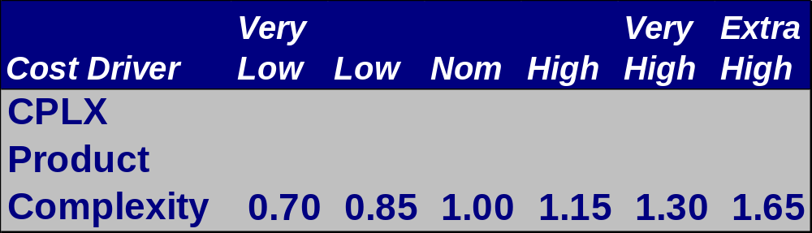
Intermediate Model: Effort Multipliers
Table of Effort Multipliers for each of the Cost Drivers is provided with ranges depending on the ratings

Slide 39
Intermediate Model:
When Should You Use It
The Intermediate Model can be applied across the entire software product for easiness and rough cost estimation during the early stage.
or it can be applied at the software product at component level for more accurate cost estimation in more detailed stages.

Slide 40
Intermediate Model: Limitations
The Intermediate Model estimates are within 20% of the actuals 68% of the time.
Its effort multipliers are phase-insensitive
It can be very tedious to use on a product with many components.

Slide 41
Intermediate Model: Cost Driver Categories

Slide 42
Product Attributes
  RELY --- Required Software Reliability
  DATA --- Data Base Size
  CPLX --- Software Product Complexity
Notes:
RELY --- Required Software Reliability
The extent to which the software product must perform its intended functions satisfactorily over a period of time.
DATA --- Data Base Size
The degree of the total amount of data to be assembled for the data base.
CPLX --- Software Product Complexity
The level of complexity of the product to be developed.

Slide 43
Computer Attributes
  TIME --- Execution Time Constraint
  STOR --- Main Storage Constraint
  VIRT --- Virtual Machine Volatility
  TURN --- Computer Turnaround Time
Notes:
TIME --- Execution Time Constraint
The degree of the execution constraint imposed upon a software product.
STOR --- Main Storage Constraint
The degree of main storage constraint imposed upon a software product.
VIRT --- Virtual Machine Volatility
The level of the virtual machine underlying the product to be developed.
TURN --- Computer Turnaround Time
The level of computer response time experienced by the project team developing the product.

Slide 44
Personnel Attributes
  ACAP --- Analyst Capability
  AEXP --- Applications Experience
  PCAP --- Programmer Capability
  VEXP --- Virtual Machine Experience
  LEXP --- Programming Language Experience
Notes:
ACAP --- Analyst Capability
The level of capability of the analysts working on a software product.
AEXP --- Applications Experience
The level of applications experience of the project team developing the software product.
PCAP --- Programmer Capability
The level of capability of the programmers working on the software product.

Slide 45
Project Attributes
  MODP --- Modern Programming Practices
  TOOL --- Use of Software Tools
  SCED --- Required Development Schedule
Notes:
MODP --- Use of Modern Programming Practices
The degree to which modern programming practices (MPPs) are used in developing software product.
TOOL --- Use of Software Tools
The degree to which software tools are used in developing the software product.
SCED --- Schedule Constraint
The level of schedule constraint imposed upon the project team developing the software product.

Slide 46
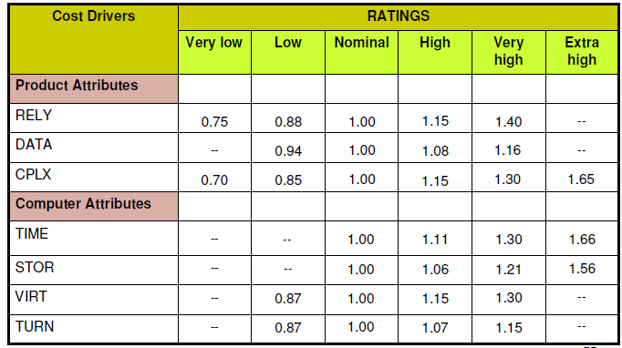
Multipliers of different cost drivers

Slide 47
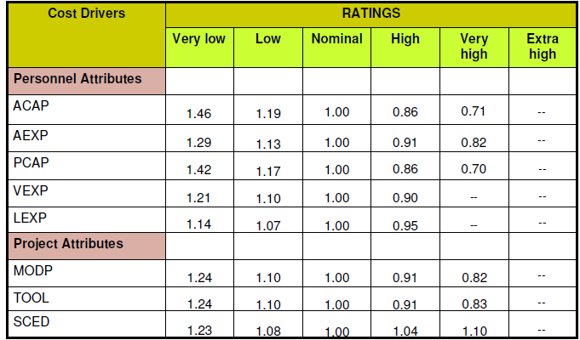
Multiplier values for effort calculations

Slide 48

Intermediate COCOMO Equations
Where E is effort, D is duration, a_{i}, b_{i}, c_{i}, d_{i} are coefficients
EAF = effort adjustment factor

Slide 49
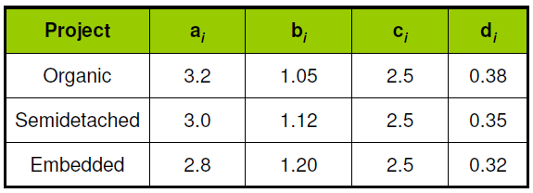
Coefficients for intermediate COCOMO

Slide 50
COCOMO Intermediate Example
If your project is using organic mode and rated Very High for Complexity (Effort Multiplier of 1.30), and Low for Tools Use (Effort Multiplier of 1.10), and all of the other cost drivers are rated to be Nominal, these Effort Multipliers are used to calculate the Effort Adjustment Factor, which is used in the effort equation:

Slide 51
Solution
Use the following formula
EAF = 1.30 * 1.10 = 1.43
From prev table the value of a_{i}, b_{i}, c_{i}, and d_{i} are 3.2, 1.05, 2.5 and 0.38 respectively
Effort = EAF * 3.2 *( 3)^{1.05} = 14.5 SM
TDEV = 2.5 * (14.5)^{0.38} = 6.9 Months
Average staffing:
14.5 / 6.9 = 2.1 people

Slide 52
Solution
There are two reasons why Intermediate model produces better results than the Basic Model.
First, It considers the effect of more cost drivers.
Second, in the Intermediate mode the system can be divided into "components".
DSI value and Cost Drivers can be chosen for individual components, instead of for the system as a whole.
COCOMO can estimate the staffing, cost, and duration of each of the components—allowing to experiment with different development strategies, to find the plan that best suits our needs and resources.

Slide 53
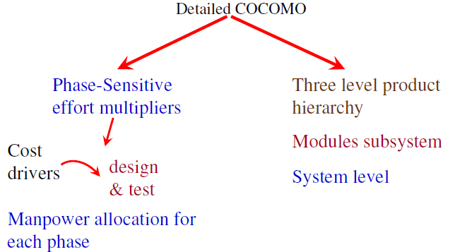
Detailed COCOMO Model

Slide 54
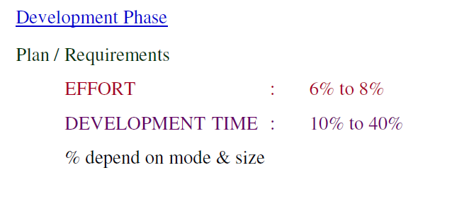
Contd…

Slide 55
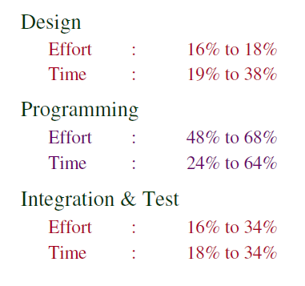

Slide 56
Detailed COCOMO Model:
How is it Different?
Phase-sensitive Effort Multipliers
The effort multipliers for every cost drivers are different during the software development phases.
Module-Subsystem-System Hierarchy
The software product is estimated in the three level hierarchical decomposition. The fifteen cost drivers are related to module or subsystem level.
Notes:
These multipliers are used to determine the amount of effort required to complete each phase.

Slide 57
Detailed COCOMO Model:
Module-Subsystem-System
  Module level
    cost drivers tend to vary at the lowest level
    CPLX, PCAP, VEXP, LEXP
  Subsystem Level
    cost drivers tend to vary from subsystem to subsystem, but are the same for modules in a sub-system
    RELY, DATA, TIME, STOR, VIRT
  System Level
    overall project relations such as nominal effort and schedule equations

Slide 58
Detailed COCOMO Model:
Equations
Detailed Model uses the same equations for estimations as the Intermediate Model.
Detailed Model uses a very complex procedure to calculate estimation. The procedure uses the DSIs for subsystems and modules, and module level and subsystem level effort multipliers as inputs.

Slide 59
Detailed COCOMO Model:
When Should You Use It?
The Detailed Model can estimate the staffing, cost, and duration of each of the development phases, subsystems, modules.
It allows you to experiment with different development strategies, to find the plan that best suits your needs and resources.

Slide 60
Detailed COCOMO Model:
Limitations
Requires substantially more time and effort to calculate estimates than previous models.
Detailed Model estimates are within 20% of the actuals 70% of the time.

Slide 61
Principle of the effort estimate
Size equivalent
  As the software might be partly developed from software already existing (that is, re-usable code), a full development is not always required.
  In such cases, the parts of design document (DD%), code (C%) and integration (I%) to be modified are estimated.
  Then, an adjustment factor, A, is calculated by means of the following equation.
  A = 0.4 DD + 0.3 C + 0.3 I

Slide 62

Contd…
The size equivalent is obtained by
S (equivalent) = (S x A) / 100

Slide 63
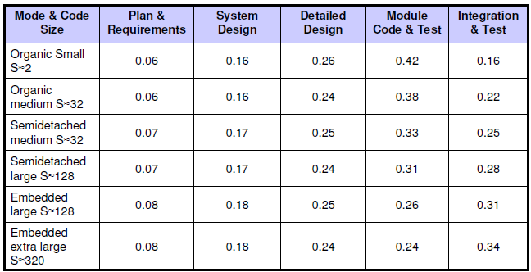
Effort fractions occurring in each phase of the lifecycle

Slide 64
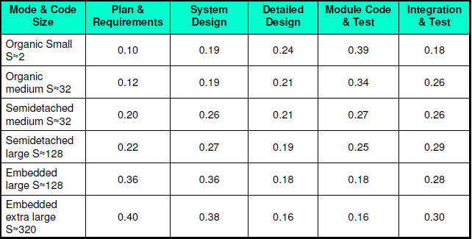
Schedule fractions occurring in each phase of the lifecycle

Slide 65
Distribution of software life cycle
Requirement and product design
  Plans and requirements
  System design
Detailed design
  Detailed design
Code & Unit test
  Module code & test
Integrate and Test
  Integrate & Test

Slide 66
COCOMO Detailed Example -2
Consider a project to develop a full screen editor. The major components identified are:
  Screen edit
  Command Language Interpreter
  File Input & Output
  Cursor Movement
  Screen Movement

Slide 67
Example
The size of these are estimated to be 4k, 2k, 1k, 2k and 3k delivered source code lines. Use COCOMO to determine:
1. Overall cost and schedule estimates (assume values for different cost drivers, with at least three of them being different from 1.0)
2. Cost & Schedule estimates for different phases.

Slide 68
Solution
Size of five modules are:
  Screen edit =4 KLOC
  Command language interpreter =2 KLOC
  File input and output =1 KLOC
  Cursor movement =2 KLOC
  Screen movement =3 KLOC
  Total =12 KLOC

Slide 69
Contd…
Let us assume that significant cost drivers are:
i. Required software reliability is high, i.e.,1.15
ii. Product complexity is high, i.e.,1.15
iii. Analyst capability is high, i.e.,0.86
iv. Programming language experience is low,i.e.,1.07
v. All other drivers are nominal
EAF = 1.15x1.15x0.86x1.07 = 1.2169

Slide 70
The initial effort estimate for the project is
obtained from the following equation:
E = a_{i} (KLOC)^{bi} x EAF
= 3.2(12)^{1.05} x 1.2169
= 52.91 PM
Development time D = C_{i}(E)^{di}
= 2.5(52.91)^{0.38}
= 11.29 M

Slide 71

Contd…
Using the following equations and referring Table phase wise cost and schedule estimates can be calculated.

Slide 72



Since size is only 12 KLOC, it is an organic small model. Phase wise effort distribution is given below:
  The value of E = 52.91 and the value of is fetched from Table -7 that are:
  System Design = 0.16 x 52.91 = 8.465 PM
  Detailed Design = 0.26 x 52.91 = 13.756 PM
  Module Code & Test = 0.42 x 52.91 = 22.222 PM
  Integration & Test = 0.16 x 52.91 = 8.465 PM

Slide 73



Contd…
Now Phase wise development time duration is calculated from the following formula:
  The value of D= 11.29 and Since the Project is Organic Small is considered from the Table -7, that is:
  System Design = 0.19 x 11.29 = 2.145 M
  Detailed Design = 0.24 x 11.29 = 2.709 M
  Module Code & Test = 0.39 x 11.29 = 4.403 M
  Integration & Test = 0.18 x 11.29 = 2.032 M

Slide 74
Example
Need to produce 10,000 LOC, 10 KLOC.
Small project, familiar development
Use organic model:
  Person-months=2.4(10)^{1.05} =26.9 Person-months
  Development-time = 2.5(26.9)^{.38} =8.7 Months
  Average People = 26.9 PM/8.7 Months = 3 People
Linear model 3 people would take 16.5 months, at 50 person-months

Slide 75
Example
We also know that the design experience is low
  Analyst, - 1.19
  application, - 1.13
  programmer experience is low. - 1.17
Yet the programming experience is high - .95
Adjustment factor 1.19*1.13*1.17*.95 = 1.49
PM = 26.9*1.49 = 40 Person-months
Development time = 10.2 Months
People = 3.9 People

Slide 76
Drawbacks
COCOMO has to be calibrated to your environment.
Very sensitive to change.
  Over a person-year difference in a 10 KLOC project with minor adjustments
Broad brush model that can generate significant errors

Slide 77
Email from Kurt Bittner
“Is COCOMO II best for iterative process?”
Yes. “(the models are) public, have evolved over almost two decades, and are based on solid, proven research with solid data.”
Caveat: COCOMO II models are “post-architectural” (best for Construction phase). (PTB Note: Cocomo II software allows for calculating and reporting by Early Design and Post Architecture)

Slide 78
Cocomo 81:
Limitations as years progressed
Software reuse
Application generation programs
Object oriented approaches
Application engineering (reuse, applications translation)
Rapid development

Slide 79
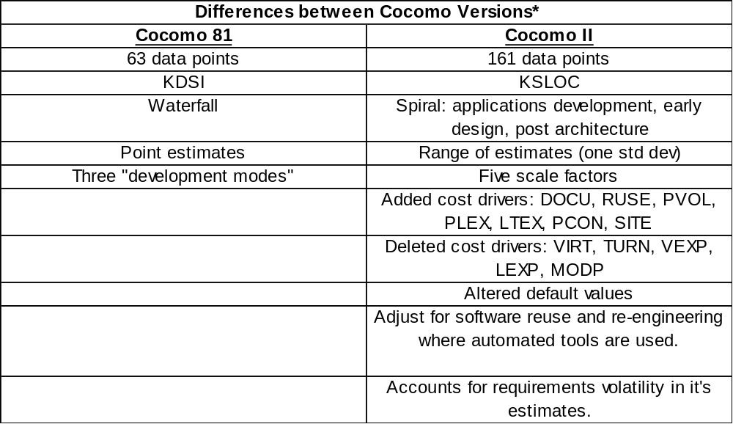
Cocomo 81 versus Cocomo II

Slide 80
COCOMO Summary
Quick and easy to use
Provides a reasonable estimate
Needs to be calibrated
Results must be treated as ball park values unless substantial validation has been performed.

Slide 81
Summary
Cost estimation models are not a substitute for a detailed estimate by task by project management.
Cost estimation models highly depend on the user’s knowledge of application domain, analysis ability and the understanding of the cost model itself.
The process of meeting the estimate is equally critical to the process of making the estimate.

